Slide 1

DEPARTMENT OF COMPUTER SCIENCE AND ENGINEERING
JAVA FULL STACK ST02 PROJECT
Kart2Kitchen
~Connecting Local Vendors & Communities
PROJECT STUDENT
Anirudh Deepak, 43110071
JF-ST02

Slide 2
AGENDA
Abstract
Existing System
Proposed System
Advantages
Disadvantages
Hardware Requirements
Software Requirements
Modules
Module Description
Sample Output (Screenshot)
Conclusion

Slide 3
ABSTRACT
The project Kart2Kitchen is a web-based platform designed to empower local vegetable vendors and communities by providing a simple, accessible digital marketplace. Inspired by the Self-Help Group (SHG) initiatives of Indian banks, which aim to provide collective strength, financial inclusion, and economic empowerment to small entrepreneurs, this system enables vendors—especially those from underprivileged or marginalized groups—to digitally showcase their produce. Vendors can register, manage their profiles, add vegetables with price and locality, and receive a unique scanner code for identification. Users can log in, browse listings, apply filters such as vegetable type, locality, or rate, and maintain a shopping cart for easy selection and comparison. Developed using HTML, CSS, JavaScript, React (concepts), Node.js, Express, and MongoDB, the platform demonstrates a complete full-stack solution. Beyond technology, the project addresses a socio-economic cause by improving transparency in pricing, reducing exploitation by middlemen, and giving small vendors digital visibility to expand their reach. In doing so, it not only strengthens community commerce but also aligns with the vision of promoting self-reliance, inclusivity, and sustainable livelihoods through digital transformation.

Slide 4
EXISTING SYSTEM
Customers currently depend on visiting local markets physically to check availability and pricing of vegetables.
No transparency exists between vendors — prices vary widely without comparison.
Vendors have limited customer reach, relying only on local traffic or word-of-mouth.
Self-Help Groups and small vendors often lack digital visibility.
This leads to time-consuming and inefficient processes for both vendors and customers.

Slide 5
PROPOSED SYSTEM
A centralized digital platform for vendors and users to interact seamlessly.
Vendors can register, log in, and add vegetables with name, rate, and area of sale.
Each vendor receives a unique scanner code for quick identification.
Users can log in, view vendors’ products, and filter them by vegetable name, locality, and price range.
Users can build a shopping cart, compare items, and view the total cost, simulating an e-commerce experience.

Slide 6
ADVANTAGES
Provides easy access to multiple vendors in one platform.
Transparency in pricing builds customer trust.
Saves time and effort for customers by enabling search and filters.
Enhances digital visibility for vendors at low cost.
Responsive design ensures usability on both desktop and mobile devices.
System can be scaled to include groceries, fruits, and household essentials.

Slide 7
DISADVANTAGES
No online payment system integrated yet (checkout is basic).
No delivery logistics — customers must collect items.
Uses localStorage for session/cart handling → not as secure as JWT-based tokens.
Entire system requires internet connectivity to function.
Being a prototype, scalability for large-scale use still needs work.

Slide 8
HARDWARE REQUIREMENTS
Server/Development Machine:
Processor: Intel i3 or higher
RAM: Minimum 4 GB
Storage: 10 GB free space
Client Device (User/Vendor):
Smartphone or PC with modern browser
Internet connectivity

Slide 9
SOFTWARE REQUIREMENTS
Frontend: HTML, CSS, JavaScript, React concepts
Backend: Node.js with Express.js
Database: MongoDB for storing vendor and user data
Libraries: bcryptjs, mongoose, cors, dotenv
OS Support: Windows, Linux, or MacOS
Browsers Supported: Chrome, Firefox, Edge

Slide 10
MODULES
User Module – Registration, login, vendor browsing, and cart access.
Vendor Module – Registration, login, and vegetable management.
Vegetable Management – Adding, updating, and deleting vegetable entries.
Cart Module – Adding/removing items, viewing totals, and managing orders.
Authentication – Secure password handling using bcrypt hashing.

Slide 11
MODULE DESCRIPTION
User Module: Provides dashboards for users to browse vendors, apply filters, and maintain shopping carts.
Vendor Module: Vendors can list vegetables with rates, manage their details, and view their scanner code.
Vegetable Management: Vendors perform CRUD (Create, Read, Update, Delete) operations for vegetable listings.
Cart Module: Users can add vegetables, remove them, calculate totals, and simulate checkout.
Authentication Module: Uses bcrypt to hash and compare passwords securely during login/registration.

Slide 12
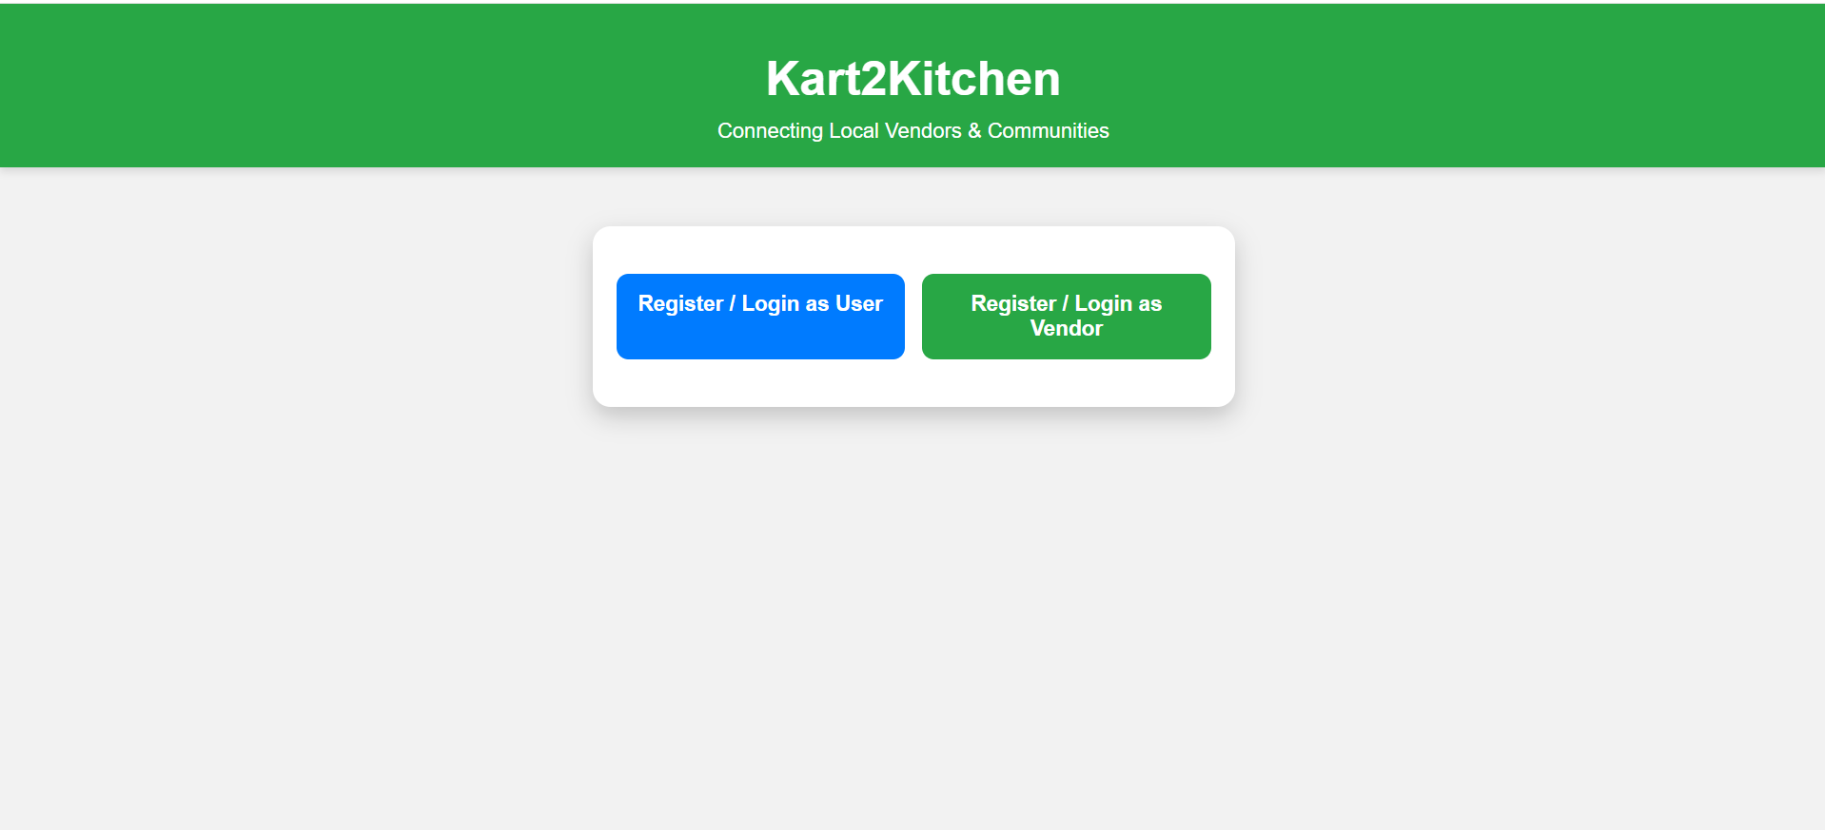
SCREENSHOTS

Slide 13
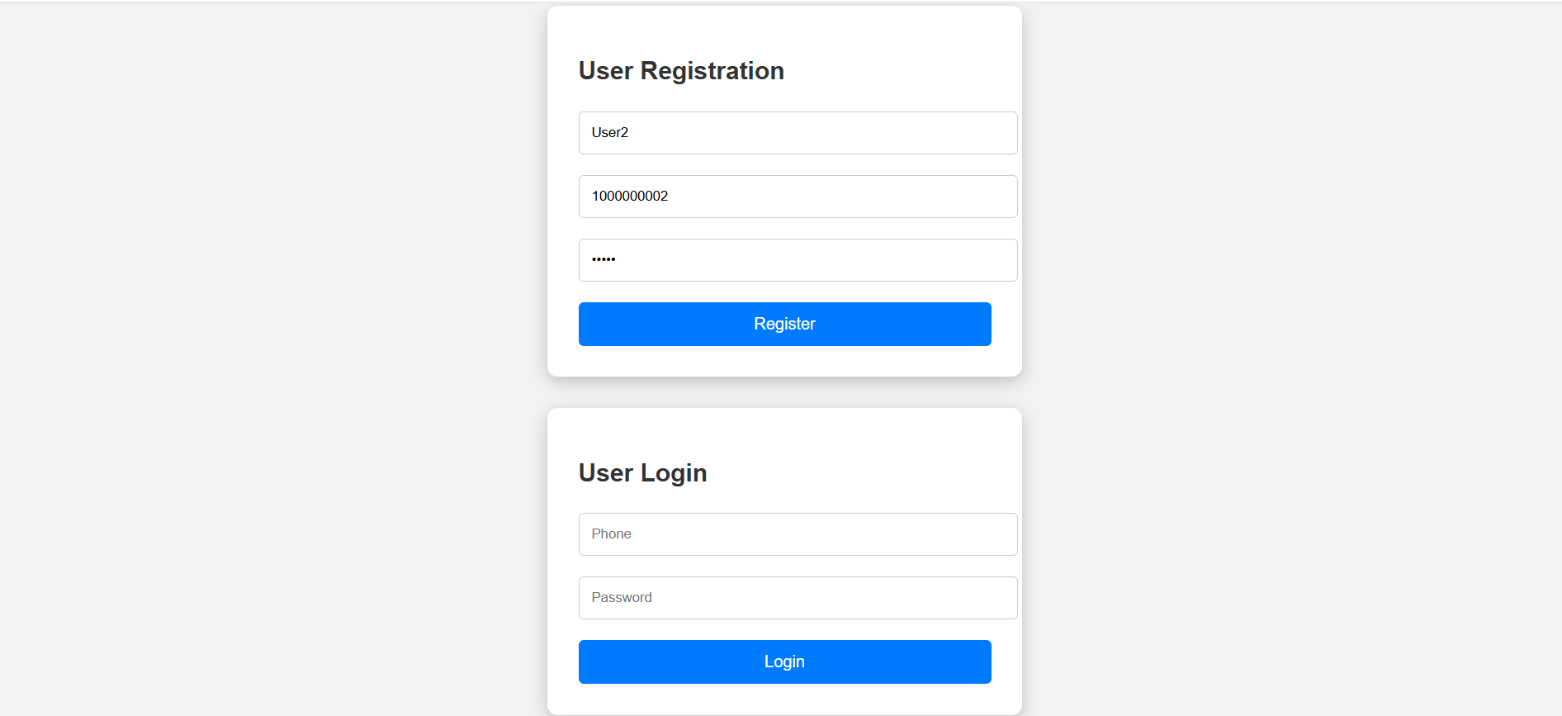
SCREENSHOTS

Slide 14
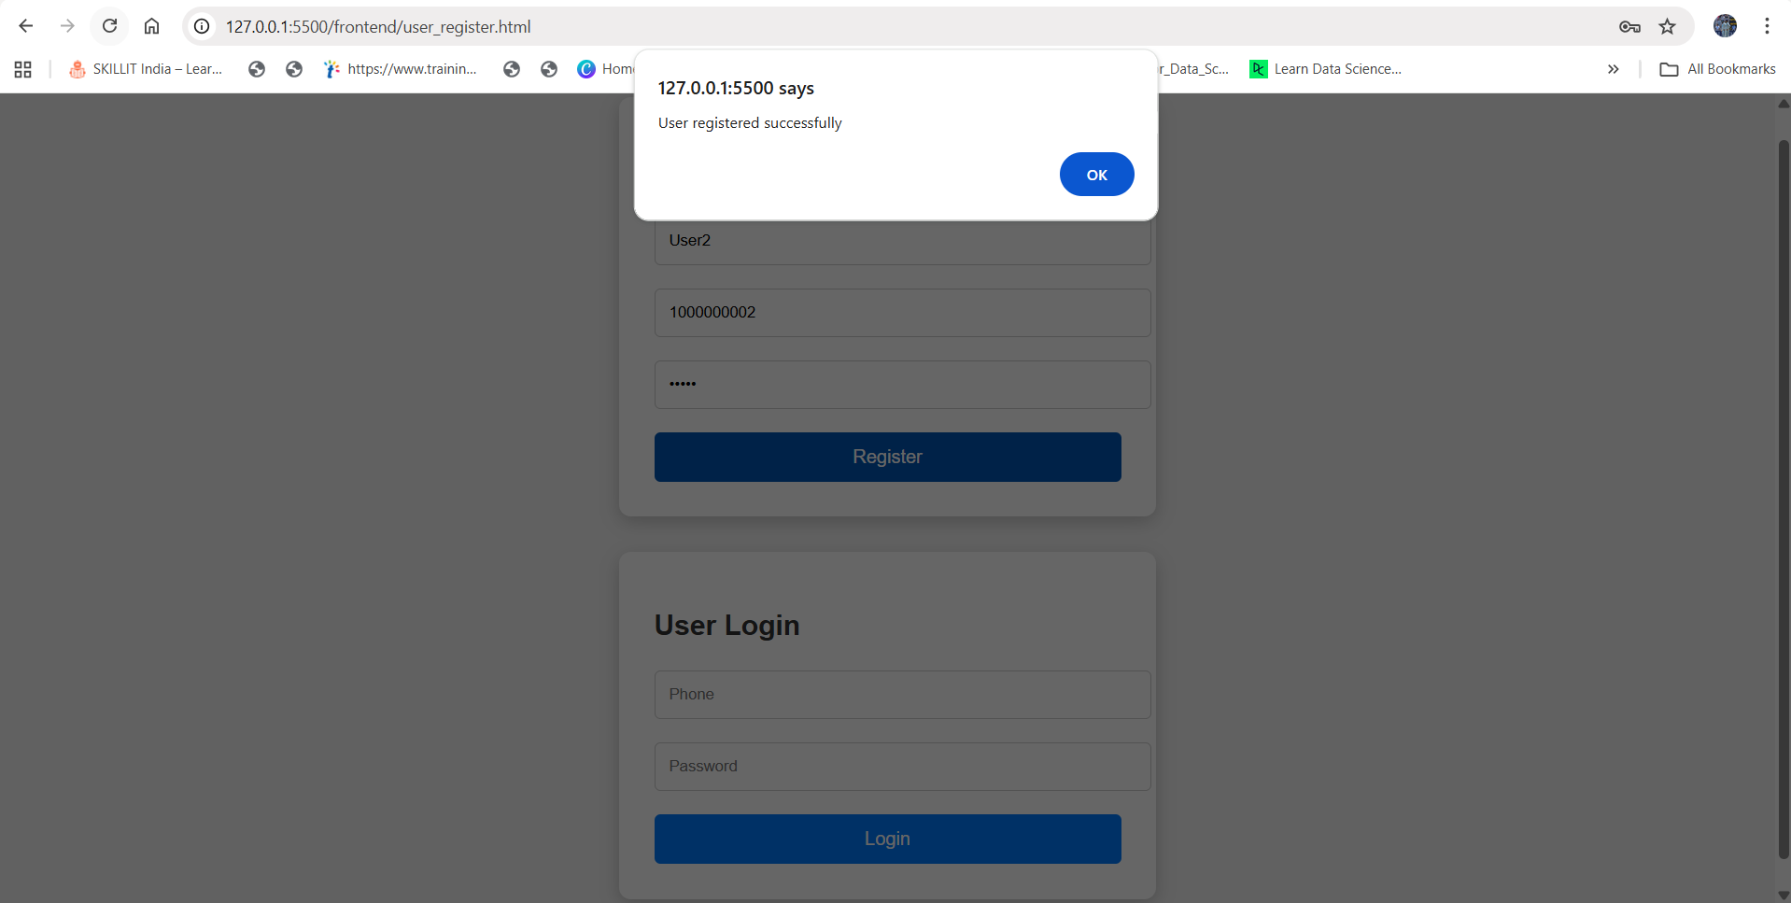
SCREENSHOTS

Slide 15
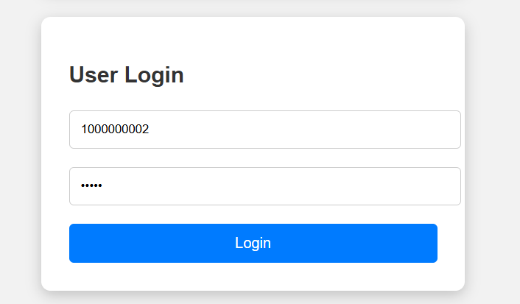
SCREENSHOTS

Slide 16
SCREENSHOTS

Slide 17
SCREENSHOTS

Slide 18
SCREENSHOTS

Slide 19
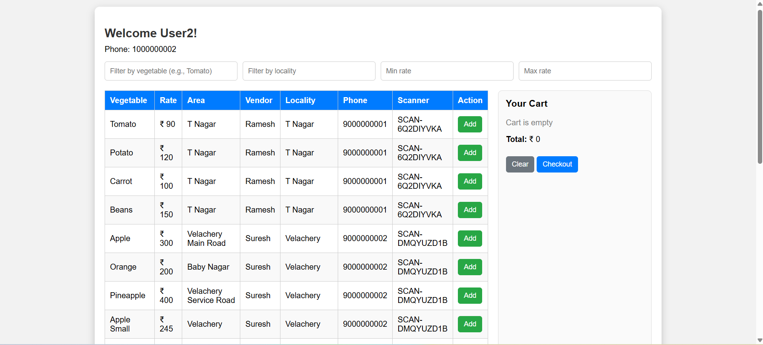
SCREENSHOTS

Slide 20
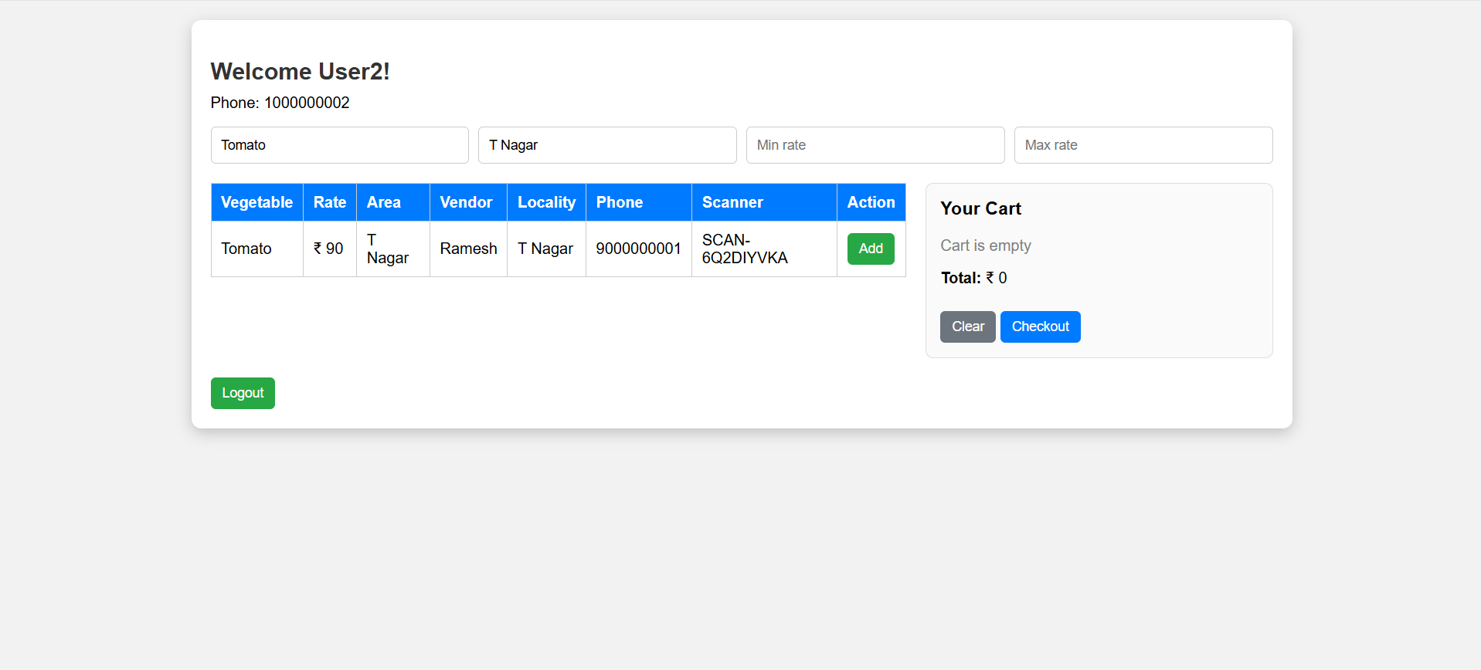
SCREENSHOTS

Slide 21
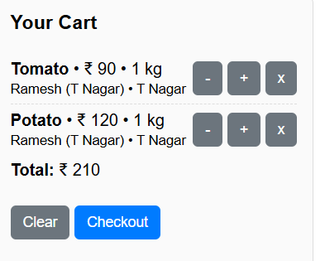
SCREENSHOTS

Slide 22
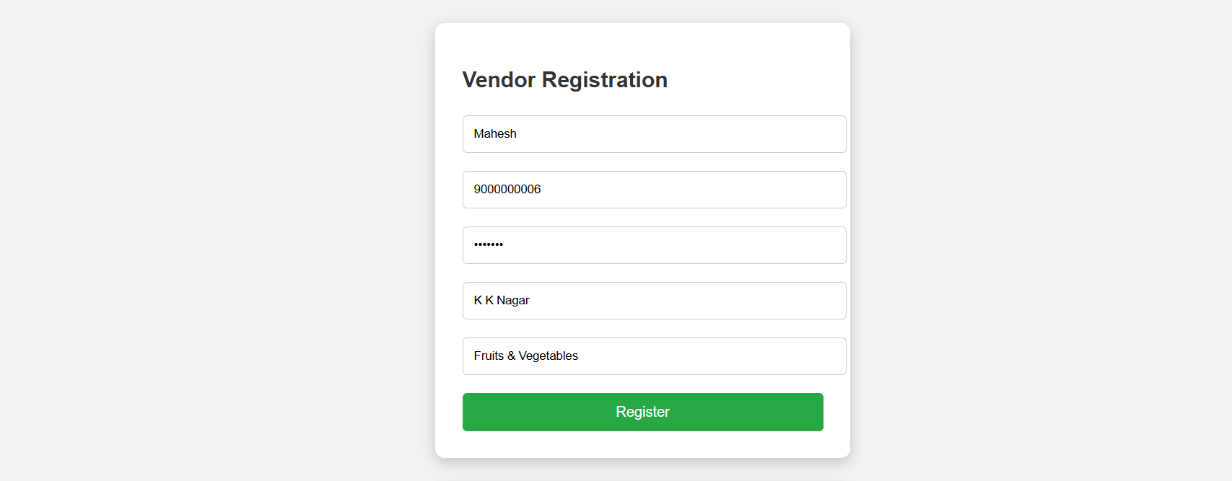
SCREENSHOTS

Slide 23
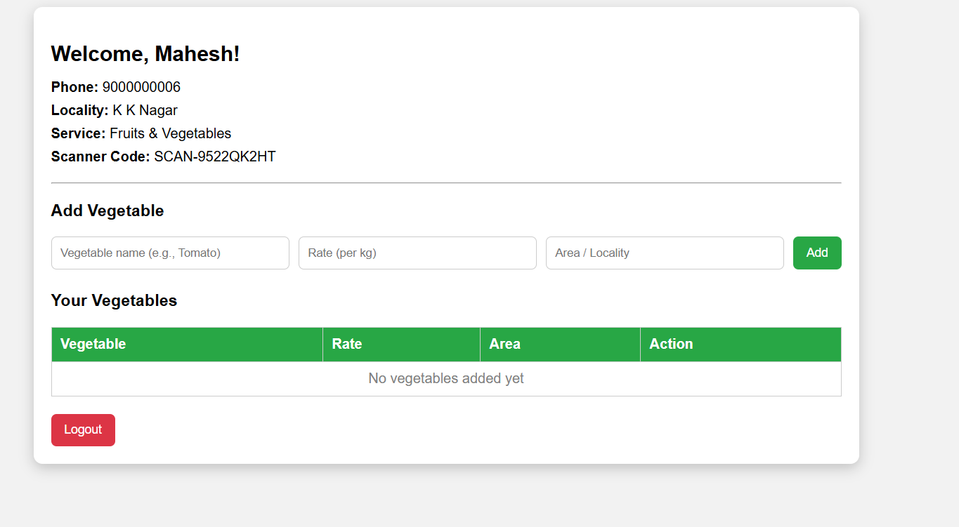
SCREENSHOTS

Slide 24
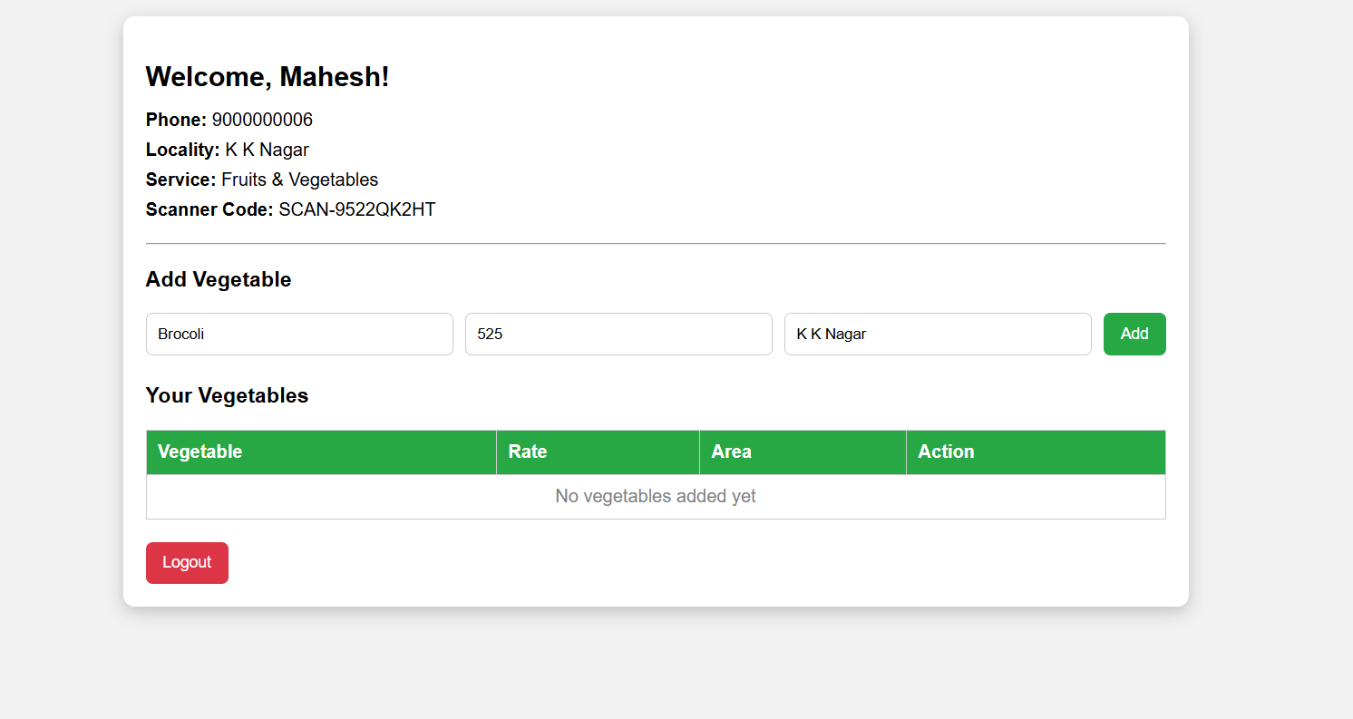
SCREENSHOTS

Slide 25
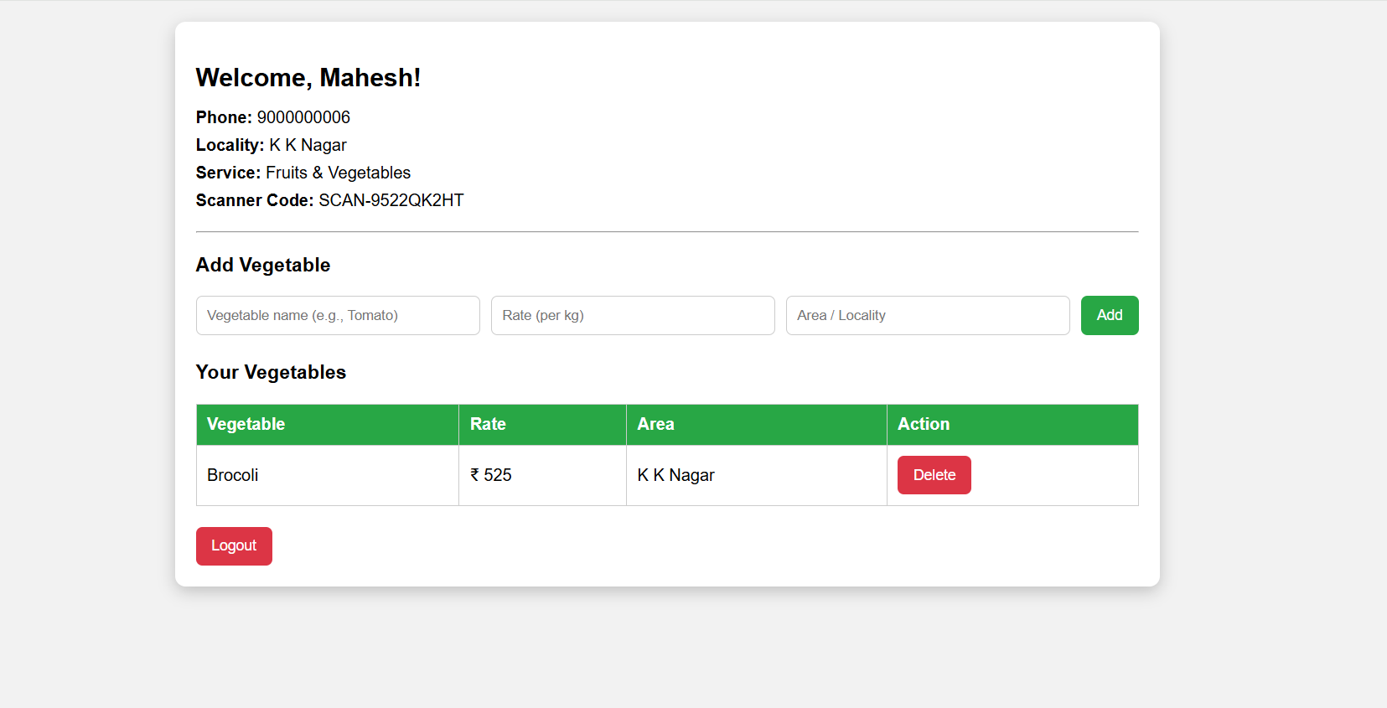
SCREENSHOTS

Slide 26
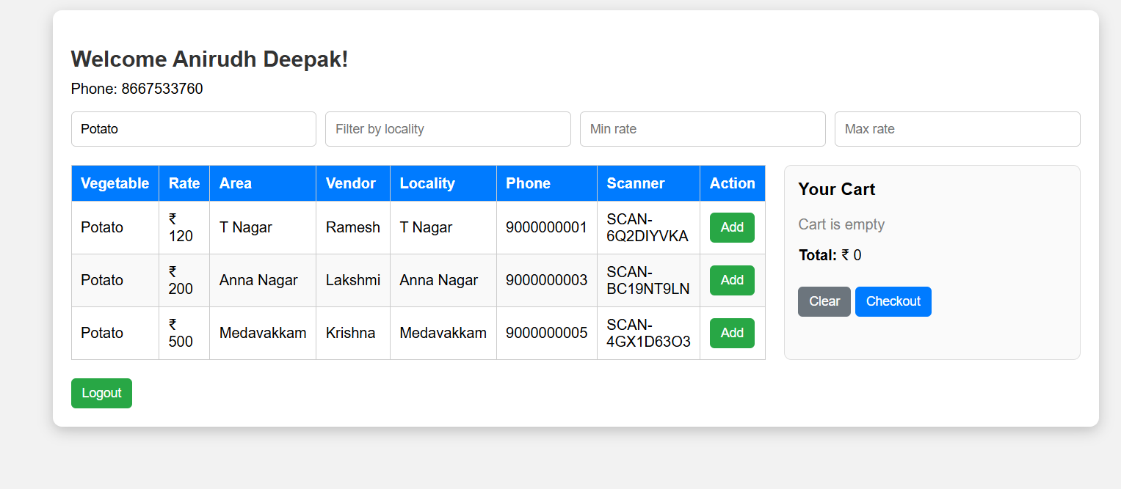
SCREENSHOTS

Slide 27
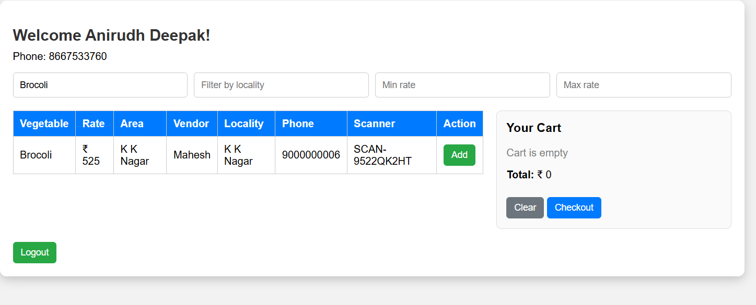
SCREENSHOTS

Slide 28
CONCLUSION
The Kart2Kitchen project successfully demonstrates how technology can support local communities by combining full-stack development with a socio-economic mission. By enabling vegetable vendors to digitally register, list their produce with prices, and reach customers directly, the platform enhances transparency and reduces dependence on middlemen. This approach resonates with the Self-Help Group (SHG) movement promoted by Indian banks, which focuses on collective empowerment, financial inclusion, and sustainable growth for small entrepreneurs. For users, the system provides convenience, price comparison, and easy access to fresh produce, while for vendors—particularly those from marginalized groups—it provides a pathway to digital visibility and improved income opportunities. Thus, Kart2Kitchen not only fulfills the technical goals of a full-stack project using HTML, CSS, JavaScript, React, Node.js, and MongoDB but also highlights the potential of technology as a tool for social upliftment, economic empowerment, and community resilience.

